Slide 1
OBSCURE SORROWS Group 18

Slide 2
The Brief
Emotively engage with the Player
Obscure Sorrows

Slide 3
Game Idea 1
Seahorse
Disaster
Reconnect

Slide 4
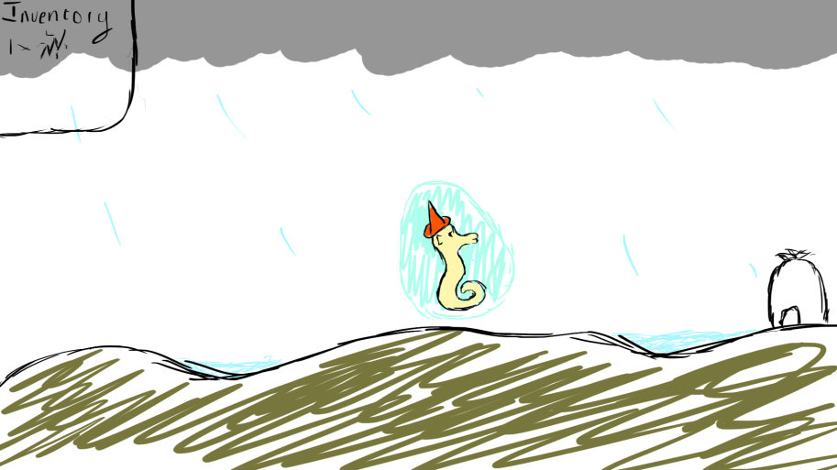
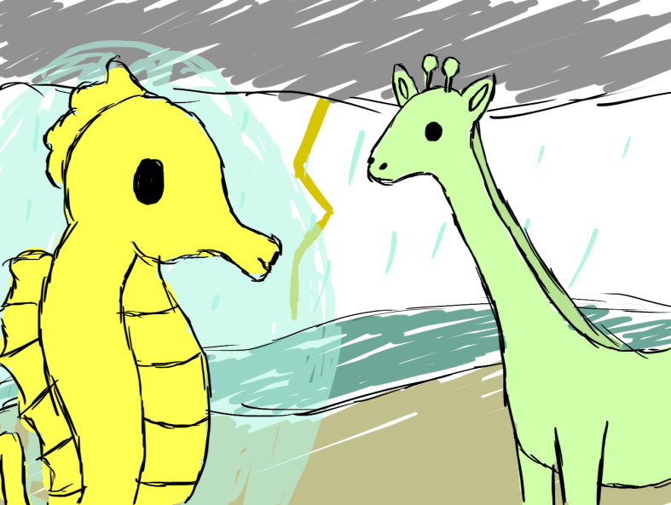
Game Idea 1 Concept Art

Slide 5
Game Idea1Player
Guide the Seahorse
Find your belongings and family
Meet other creatures
Return Home

Slide 6
Game Idea 1 Emotions
Chrysalism: The amniotic tranquillity of being indoors during a thunderstorm.
Monochopsis: The constant but subtle feeling of being out of place.

Slide 7
Game Idea 2
Ghost
Lonely and Bored
Create Death

Slide 8
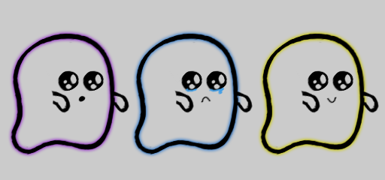
Game Idea 2 Concept Art

Slide 9
Game Idea 2 Player
Guide the Ghost
Set Up A Chain Reaction
Upgrade Abilities

Slide 10
Game Idea 2 Emotions
Monachopsis: The subtle but persistent feeling of being out of place.
Anecdoche: A conversation in which everyone is talking but nobody is listening.

Slide 11
Questions?

